Slide 1







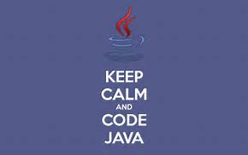
JAVA…..
OOP’s Concept

Slide 2
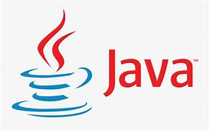
CONCEPTS/ TOPICS
OOP’s :-
Object
Class
Encapsulation
Inheritance
Polymorphism
Abstraction

Slide 3
JAVA:-
Object Oriented Programming System-OOP’S
Java Is A High-Level Programming Language.
JAVA Is Platform-Independent i.e It Can Run On Any Platform.
OOP’S Is One of The Feature Of Java.
JAVA Is Object Oriented Programming Language.
Java Uses Java Development Kit(JDK) For Compilation And Java Runtime Environment(JRE) For Execution.

Slide 4
Object
Real World Entity
Consits
States
And
Behavior
….

Slide 5
Object:-
. A Real World Entity That Consists Of States And Behavior.
. States:- Qualities/The Things That An Objects Contains
. Behavior:-The Things That Are Done By An Object.
. The Input Is Given By the Help Of Object Only.

Slide 6
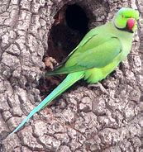
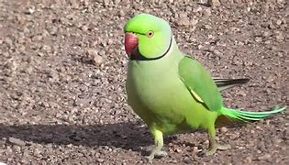
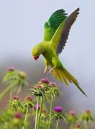
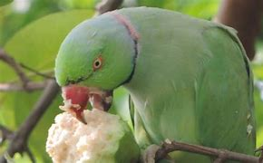
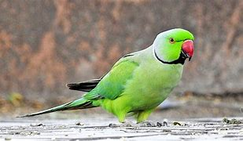

OBJECT
STATES: (What it has)
BEHAVIOR: (What it do’s/does)

Slide 7
Syntax:-
To create object for any class:
Classname object=new Classname( );

Slide 8
Class
DATA MEMBERS AND
MEMBER FUNCTIONS
COLLECTION OF

Slide 9
CLASS- * Class Is A Collection Of Objects.
. Class Is A Collection Of Data Members And Member Functions.
. Data Members Are Variables Used Inside Class.
. Members Functions Are Functions/Methods Used Inside Of Class.
. Class Is Also An User Defined Data Type.

Slide 10



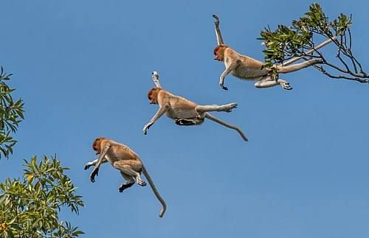
CLASS
DATA MEMBERS
MEMBER FUNCTIONS
STATES
Features Of An Object
BEHAVIOR
Work/Action Done By The Object

Slide 11

CLASS
Access Specifier:-
PUBLIC
PRIVATE
PROTECTED
Syntax
Class Classname
{
Access specifier Data members;
Access specifier Member function()
{
Block of statements;
}
}

Slide 12
ABSTRACTION
DATA HIDING
ABSTRACT KEY

Slide 13
ABSTRACTION- * Data Hiding
Process Of Hiding Data From An User.
Abstraction Is Achieved By Abstract Classes And Interfaces.
“Abstract” Keyword Is Used To Declare Abstract Class.
If A Class Contains An Abstract Method Then Class Should Be Declared With Abstract.
Members Defined With Public Access Specifier Are Accessible Throughout The Program.
Members Defined With Private Access Specifier Are Not Accessible Throughout The Program. Only Accessible With It’s Own Class.

Slide 14





ABSTRACTION:-
HIDING

Slide 15
Syntax- * Rules Are The Syntax For Abstraction
This Method Can Only Be Used In An Abstract Class.
It Does not Have A Body.
The Body Is Provided By The Subclass(Inherited Form).
Starting Of A Syntax Must Be Access Modifier.
To Declare An Abstract Class , We Use:- a) Access Modifier First
b) Abstract Key
c) Class name

Slide 16
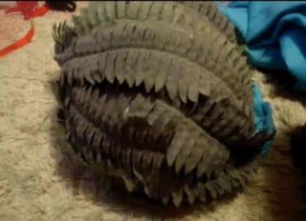

ABSTRACTION

Slide 17
ENCAPSULATION
Covering Of Data Members And Member Functions
By The Help Of:-
Access Specifier

Slide 18
ENCAPSULATION:- * Data Covering
Process Of Covering The Data From An User.
It Can Be Also Defined As The Process Of Covering Of Data Members And Member Functions.
It Is The Security Of A Class OR For A Class.
It Is Used To Prevent The Direct Accessibility Of Data Members And Member Function.
Process Of Wrapping Code And Data Together Into A Single Unit.

Slide 19






ENCAPSULATION-

Slide 20
Syntax
(Rules)
This Is Done By Using Access specifier public ,private ,protected.
Public:
It allows the accessibility of data member and member function to the other classes.
Public element of a class can be accessed anywhere in the program.
It is used to hide data member and member function from the other classes.
Private element of a class can be accessed only inside in its own class.
Private element of a class cannot be accessed outside the class
It is approximately same as private but it allows the accessibility of data member and member function to the child class.
Protected is used in the case of inheritance.
ENCAPSULATION

Slide 21




ENCAPSULATION

Slide 22
Inheritance
Process Of Deriving One Class Properties To Another Class

Slide 23
INHERITANCE- * Heredity
The Process Of Deriving One Class Properties To Another Class
Keyword Used:- “ EXTEND ”.
Contains Two Classes:- Parent Class & Child Class.
Child Class Contains The Properties Of Both Child Class And Parent Class Too.
Process Of Deriving New Class From Old Class i.e, Base Class From A Derived Class.

Slide 24
TYPES OF INHERITANCE
SINGLE
MULTIPLE
MULTIPATH
HIERAR-HICAL
MULTILEVEL
HYBRID

Slide 25
SINGLE INHERITANCE
Derivation Of A class From Only One Bae Class
BASE
DERIVED

Slide 26
Derivation Of A Class From Two Or More Base Classes
MULTIPLE INHERITANCE
Base 1
Base 2
Base n
Derived

Slide 27
HIERARCHICAL INHERITANCE
Derivation Of Several Classes From One Base Class i.e. One Class May Be Inherited By More Than One Class
Base
Derived 1
Derived 2
Derived 3
Derived 4
Derived 5

Slide 28
Multilevel Inheritance
Base
Derived 1
Derivation Of A Class From Another Derived Class
Derived 2

Slide 29
HYBRID INHERITANCE
Base 1
Derived 1
Base 2
Derivation Of A Class Involving More Than One Form Of Inheritance
Derived 2

Slide 30
MULTIPATH INHERITANCE
Base 1
Derived 1
Derived 2
Derivation Of A Class From Other Derived Classes Which Are Derived From The Same Base Class
Derived 3

Slide 31
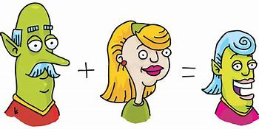
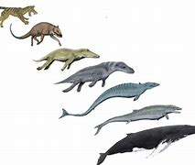
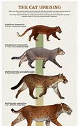
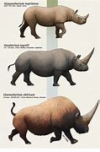


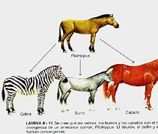
INHERITANCE

Slide 32
Keyword Must Be Used
Derived Class name Must Be Given
Syntax
(Rules)
When a class inherits the property of a class it means it access all the data member and member function of that class except private element.
INHERITANCE

Slide 33



POLYMORPHISM
Many Forms

Slide 34
POLYMORPHISM- * Many Forms
Process Of Using One Member Function In Many Forms
One Member Function Will Be Having Many Forms , They Cn Be Called Using Parameters.
Parameters Are Stores In B/W Paranteses ( ) . They Can Store Values , Variables And Functions/Methods Too.

Slide 35
TYPES OF POLYMORPHISM
Function
Overloading
Function
Overriding

Slide 36




POLYMORPHISM
FUNCTION OVERLOADING
FUNCTION OVERRIDING
Same Function Name With Same Parameters.
It Executes During Inheritance.
Requires The Concept Of Inheritance.
By This Hacking Can Be Done.
Same Function Name With Different Parameters.
Calling Can Be Done With The Parameters.

Slide 37
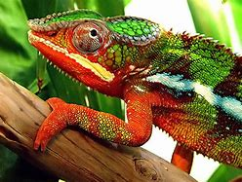
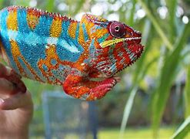
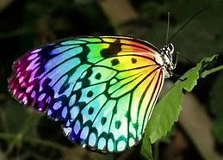

Polymorphism

Slide 38
Syntax
(Rules)
Inheritance Concept Is Required
Parameters Are Must
Object Is Required
Methods Are Required For Calling
POLYMORPHISM

Slide 39
IMPLEMENTATION

Slide 40
// object implementation
import java.io.*;
import java.lang.*;
import java.util.Scanner;
class Object
{
int a,b,c; //data members
void Area() //member function
{
c=a*b;
System.out.println("\t area of rectangle is \t"+c);
}
public static void main(String args[])
{
Object l=new Object(); //creating object for class rectangle
l.a=20;
l.b=10; //accessing data member
l.Area(); //accessing member function
}
}
OBJECT:-

Slide 41
CLASS:-
// class implementation
import java.io.*;
import java.lang.*;
import java.util.Scanner;
class Class
{
public static void main(String args[])
{
int a=10,b=5,c;
c=a+b;
System.out.println("\t add is \t"+c);
}
}

Slide 42
// abstraction implementation
import java.io.*;
import java.lang.*;
import java.util.Scanner;
abstract class Car
{
abstract void chasing();
public void braking()
{
System.out.println("car brakes at one point");
}
}
class Test extends Car
{
public void chasing()
{
System.out.println("car chases another one");
}
}
class Abstraction
{
public static void main(String args[])
{
Test l=new Test();
l.chasing();
l.braking();
}
}
ABSTRACTION:-

Slide 43
// encapsulation implementation
import java.io.*;
import java.lang.*;
import java.util.Scanner;
class Student
{
public void name()
{
System.out.println("chinna");
}
public void hair()
{
System.out.println("long");
}
public void study()
{
System.out.println("four");
}
public void medium()
{
System.out.println("english");
}
private void school()
{
System.out.println("sri chaitanya");
}
private void hose()
{
System.out.println("bangalore");
}
}
class Encapsulation
{
public static void main(String args[])
{
Student l=new Student();
l.name();
l.hair();
l.study();
l.medium();
}
}
ENCAPSULATION:-

Slide 44
// inheritance implementation
import java.io.*;
import java.lang.*;
import java.util.Scanner;
class Addition
{
void add()
{
int a=10,b=20,c;
c=a+b;
System.out.println("\t addition is \t"+c);
}
}
class Substraction extends Addition
{
void sub()
{
int a=10,b=20,c;
c=b-a;
System.out.println("\t substraction is \t"+c);
}
}
class Inheritance
{
public static void main(String args[])
{
Substraction l=new Substraction(); //creating object (instance) for class substraction
l.add(); //(accessing or calling) member function with object
l.sub();
}
}
INHERITANCE:-

Slide 45
// function overloading implementation
import java.io.*;
import java.lang.*;
import java.util.Scanner;
class Poly
{
void a()
{
System.out.println("\t no parameter \t");
}
void a(int i)
{
System.out.println("\t integer parameter \t");
}
void a(String s)
{
System.out.println("\t String parameter \t");
}
void a(Double d)
{
System.out.println("\t Double parameter \t");
}
}
class Overloading
{
public static void main(String args[])
{
Poly l=new Poly();
l.a();
l.a(25);
l.a("done");
l.a(1.777);
}
}
POLYMORPHISM
(Function Overloading):-

Slide 46
POLYMORPHISM
(Function Overriding):-
// function overriding implementation
import java.io.*;
import java.lang.*;
import java.util.Scanner;
class Apple
{
void color( String s)
{
System.out.println("\t red color \t");
}
}
class Banana extends Apple
{
void color(String s )
{
System.out.println("\t yellow color \t");
}
}
class Overriding
{
public static void main(String args[])
{
Banana l=new Banana();
l.color("fruits");
}
}

Slide 47


THANK YOU ALL

